Slide 1

Data analysis presentation
Sprocket Central Pty Ltd

Slide 2

Fact
The first recognizable bicycle-like machine “the draisine”, was invented by the German Karl von Drais in 1817. It lacked pedals and riders propelled themselves with their feet. His design was quickly replaced by more advanced “velocipede” designs that had a pedal transmission.

Slide 3
In God we trust. All others must bring data.
”
- W. Edwards Deming

Slide 4
01
02
Introduction
Data Exploration​
03
04
Model Development​
Interpretation​
A brief introduction to the presentation anchor points
What the data told us at first glance
The data has more to say if properly analyzed
Let’s thoroughly understand what the data has to say

Slide 5
01
Introduction
A brief introduction to the presentation anchor points

Slide 6
Goal of this presentation
Unleashing High-Value Growth: Targeting Sprocket Central's Next Customers
Good morning/afternoon everyone,
Today, we embark on a data-driven journey to unlock Sprocket Central's hidden growth potential! We're not just analyzing transactions, but delving into a treasure trove of 1,000 new customer profiles. By uncovering their hidden preferences and predicting their next move, we aim to:
Identify Sprocket Central's goldmine: Pinpoint the high-value segments within this untapped audience, revealing who's most likely to become loyal riders.
Precision-target your marketing: Ditch the shotgun approach! We'll craft laser-focused campaigns tailor-made to ignite purchase interest in these ideal customers.
Maximize your marketing ROI: Invest with confidence, knowing you're reaching the right individuals at the right time, driving profitable engagement.
This three-week adventure unfolds in three exciting stages:
Data Exploration: We'll unpack the secrets hidden within your existing customer data and these new profiles, understanding their demographics, habits, and buying patterns.
Model Development & Training: We'll build a powerful predictive model, fueled by insights from exploration, to accurately identify the most promising potential customers.
Results Interpretation & Reporting: No model is complete without clear communication. We'll translate data into actionable insights, presenting a roadmap to target your high-value audience with precision and confidence.
Throughout this journey, we'll leverage external data, transform raw fields for optimal analysis, and keep you informed every step of the way. By the end, you'll be equipped with a data-driven blueprint to fuel Sprocket Central's growth and conquer the cycling market!
Get ready to unleash the power of data and discover your most valuable customers! Let's begin!

Slide 7
Whoa!
Sprocket Central, buckle up! We're unlocking growth with 1,000 new customers.
Forget guesswork, let data guide your marketing! In 3 weeks, we'll:
Find your high-value riders: pinpoint who's likely to buy.
Target them like pros: laser-focused campaigns for max impact.
Maximize your ROI: spend smarter, not harder.
Data exploration, model building, and actionable insights – prepare to win the cycling market! Let's dive in.

Slide 8
Well!
Let the journey begin!

Slide 9
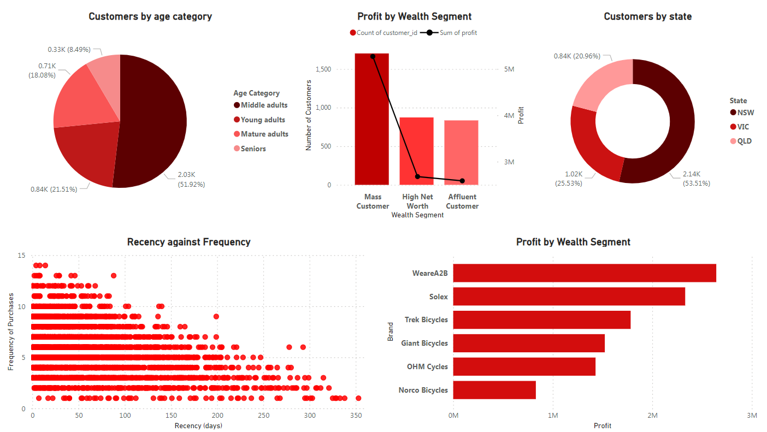
Overview

Slide 10
02
Data Exploration​
This is what the data told us at first glance

Slide 11
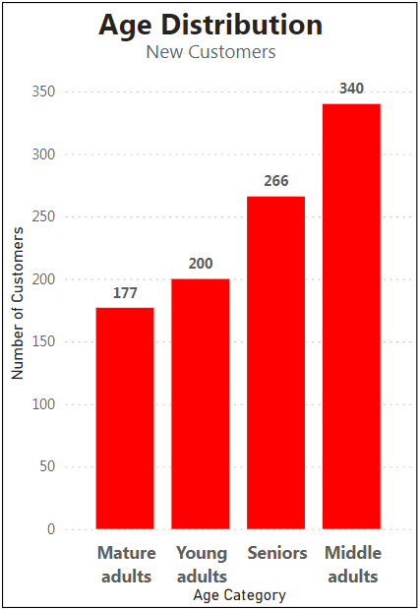
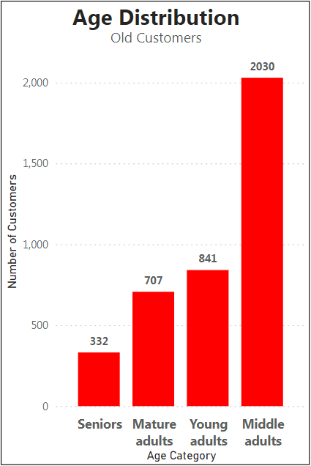
Age Distribution
Across both new and existing customers, the largest group falls in the middle-aged adult category (34-54 years old).
We see a strong mix of middle-aged adults (34-54) and seniors (65+) among our new customers.
The old customers dataset has a minority of Seniors aged 65+.
both new and existing customers separately have roughly equal proportions of young adults (21-34) and mature adults (55-64).
Young adults = 21 - 34 Middle adults = 34 -54
Mature adults = 55 -64 Seniors = 65+

Slide 12
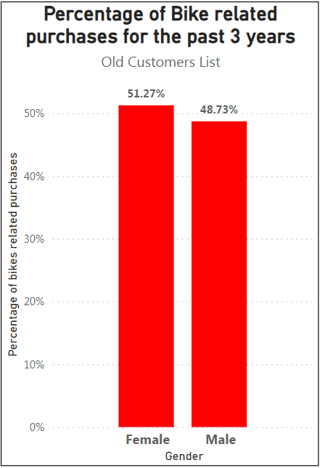
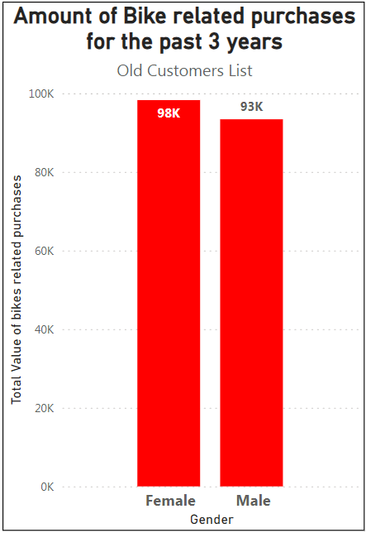
Bike Related Purchases
Old Customers Dataset
In the past 3 years, our data shows that female customers purchased slightly more bikes than male customers.
Specifically, females made about 5,000 more bike-related purchases than males. This translates to 2.54% of all purchases made during that time.

Slide 13
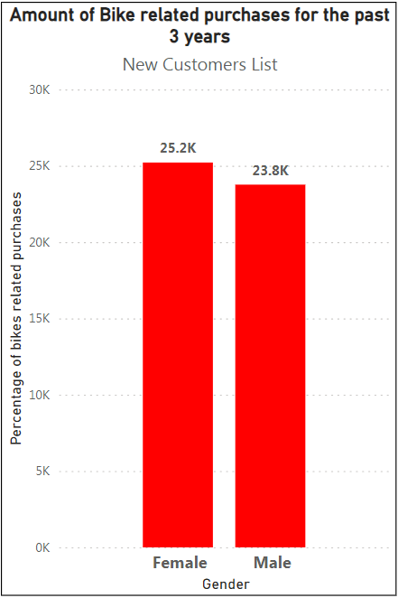
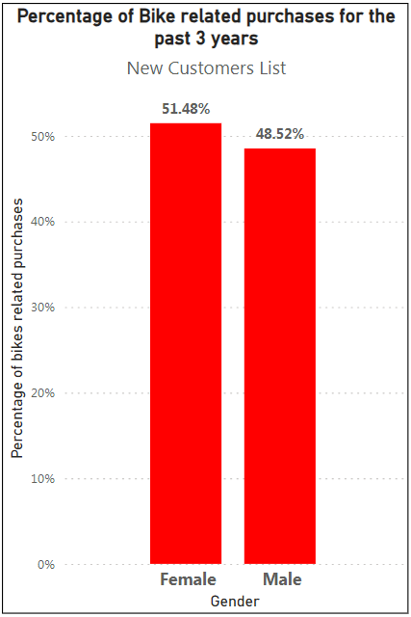
Bike Related Purchases
New Customers Dataset
In our new customer data, we've noticed a trend over the past 3 years: female customers are making slightly more bike-related purchases than males.
Specifically, females have made roughly 1400 more bike purchases compared to males during this time period. This translates to about 2.96% of all bike purchases.

Slide 14
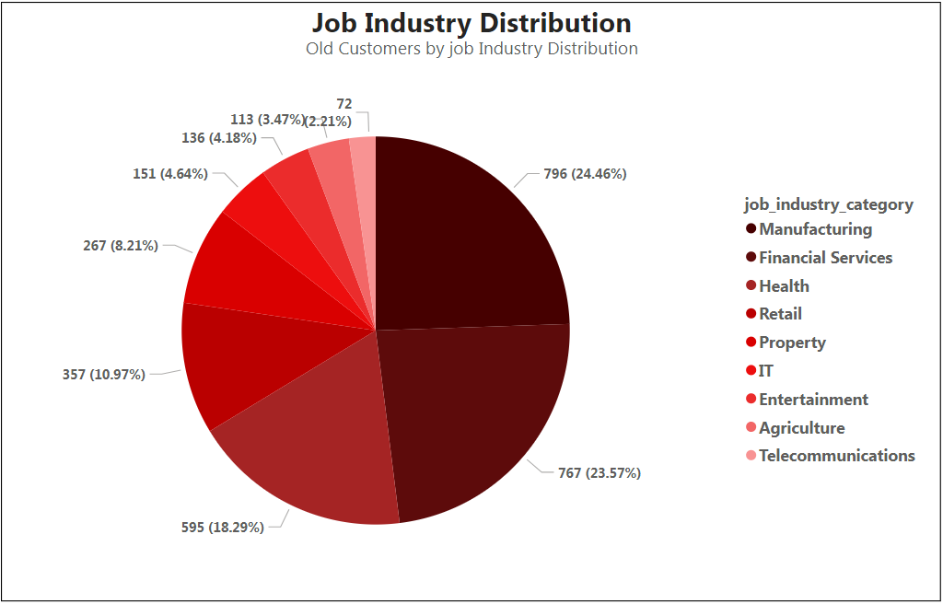
Job Industry Distribution
Old Customers Dataset
Nearly half (around 48%) of our customers come from manufacturing and financial services.
The health and retail sectors together make up another 30%.
Manufacturing is our biggest group, with roughly a quarter (24.46%) of all our customers.
Telecommunications is on the smaller side, accounting for 2.21%.

Slide 15
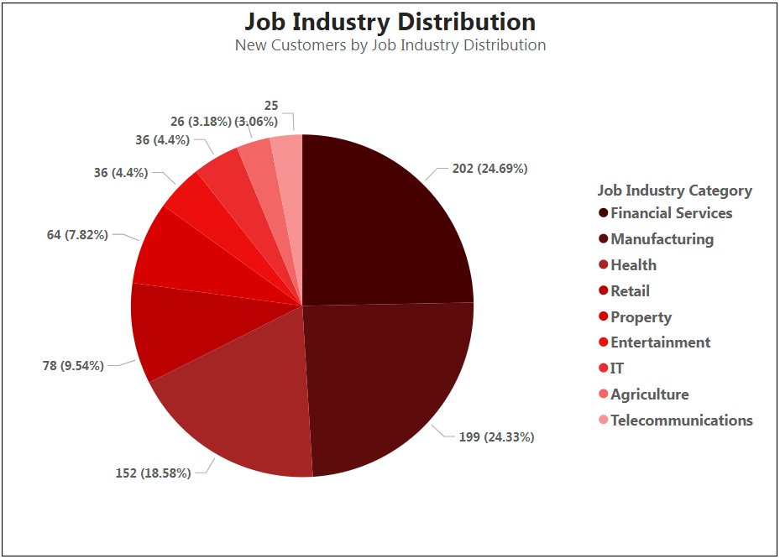
Job Industry Distribution
New Customers Dataset
Similar to our existing customers, new customers in manufacturing and financial services make up about half (around 50%) of our data. The health and retail sectors come in second at roughly 28%.
Within the new customer group, financial services takes the lead with nearly a quarter (24.69%) of the total. Manufacturing follows closely behind at 24.33% – it's almost a tie!
Telecommunications rounds out the group with a smaller share, contributing around 3% of the new customers.

Slide 16
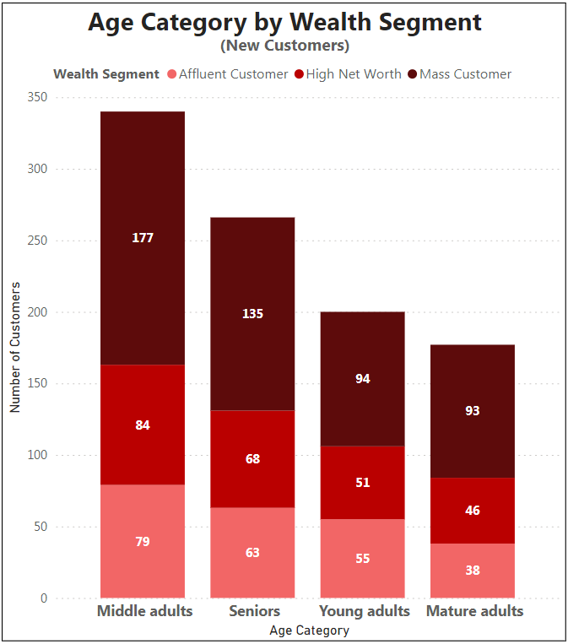
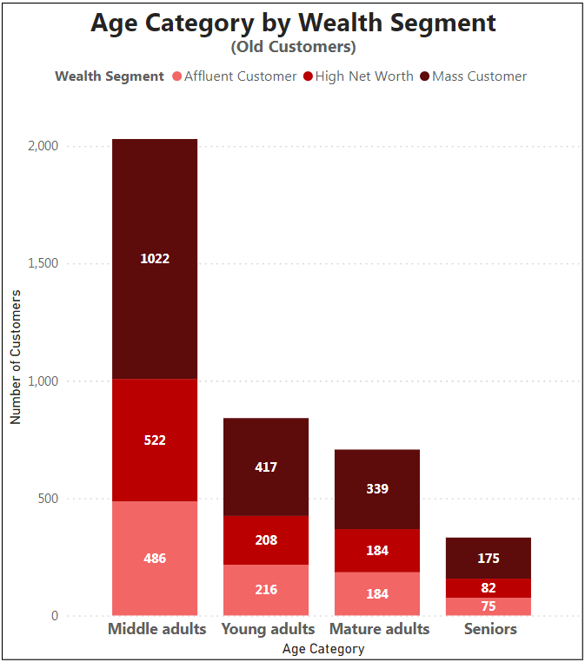
Age Category by Wealth Segment
The majority of our customers fall into the "mass customers" group. This includes both new and existing customers, and spans across all age categories.
High-net-worth individuals make up the second-largest customer segment across most age categories.
Young adults are a bit of an exception, with a slightly larger number of affluent customers compared to high-net-worth individuals.

Slide 17
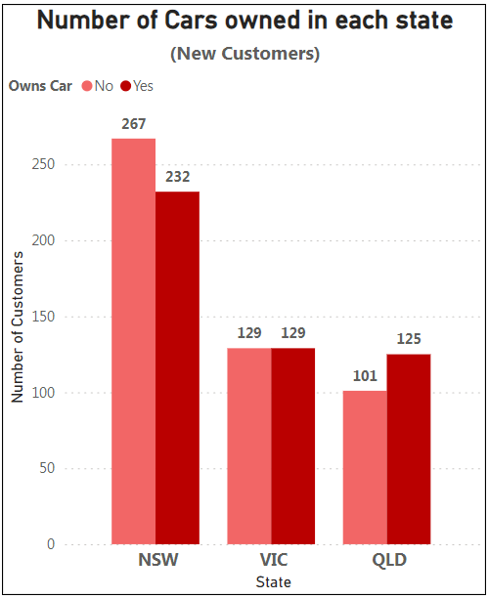
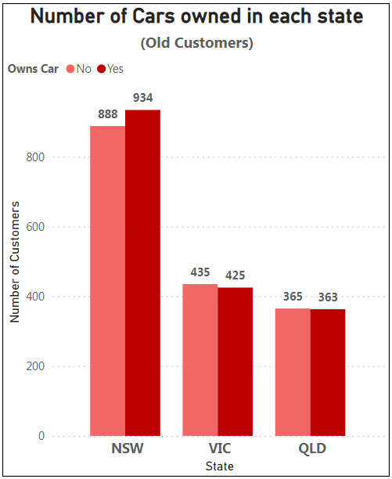
Cars Ownership
It appears New South Wales (NSW) has the most customers overall, regardless of car ownership.
Among existing customers, NSW has a slightly higher proportion of car owners compared to the other two states (QLD, VIC)
Interestingly, car ownership trends differ slightly for new customers. In QLD, there are slightly more car owners than non-car owners, while NSW has a bit fewer car owners. Victoria shows an even split between car owners and non-car owners for new customers.

Slide 18
03
Model Development​
The data has more to say if properly analyzed

Slide 19
RFM Segmentation
RFM segmentation is a marketing technique used to identify and group customers based on their recent purchase history.
It considers three key factors:
Recency
Frequency
How recently a customer made a purchase
How often a customer makes purchases
Monetary
How much a customer spends per purchase

Slide 20
RFM Segments
RFM is a behavior-based segmentation approach, which stands for Recency, Frequency, and Monetary value, each corresponding to key customer trait. These RFM metrics are important indicators of a customer’s behavior because:
frequency and monetary value affect a customer’s lifetime value, and
recency affects retention, a measure of engagement.
RFM factors illustrate these facts:
The more recent the purchase, the more responsive the customer is to promotions.
The more frequently the customer buys, the more engaged and satisfied they are.
Monetary value differentiates heavy spenders from low-value purchasers or users.
How RFM Segmentation works:
We give every customer a score from 1 to 5 on every factor. The most active customer should have a score of 5 on each of recency, frequency and monetary, that gives him a 555 score in total, and the least active customer should have the score 1 on all factors and his total score is 111.

Slide 21
RFM Segments
Champion
Bought recently, order often, and spend the most.
Loyal
Orders regularly. Responsive to promotions.
Potential Loyalist
Recent customers, and spent a good amount.
New Customers
Bought most recently.
Promising
Spends frequently and a good amount. But the last purchase was several weeks ago.
Needs attention
Core customers whose last purchase happened more than one month ago.
About To Sleep
Standard customers with quite too long-ago purchases.
At Risk
Similar to “Can’t lose them but losing” but with smaller monetary and frequency value.
Can’t lose them
Made the largest orders, and often. But haven’t returned for a long time.
Hibernating
Made their last purchase a long time ago but still engaged with the business.
Lost
Made last purchase a long time ago and didn’t engage at all in the last 4 weeks.

Slide 22
RFM Score-based Segments
Champion
555, 554, 544, 545, 454, 455, 445
Loyal
543, 444, 435, 355, 354, 345, 344, 335
Potential Loyalist
553, 551, 552, 541, 542, 533, 532, 531, 452, 451, 442, 441, 431, 453, 433, 432, 423, 353, 352, 351, 342, 341, 333, 323
New Customers
512, 511, 422, 421 412, 411, 311
Promising
525, 524, 523, 522, 521, 515, 514, 513, 425,424, 413,414,415, 315, 314, 313
Needs attention
535, 534, 443, 434, 343, 334, 325, 324
About To Sleep
331, 321, 312, 221, 213, 231, 241, 251
At Risk
255, 254, 245, 244, 253, 252, 243, 242, 235, 234, 225, 224, 153, 152, 145, 143, 142, 135, 134, 133, 125, 124
Can’t lose them
155, 154, 144, 214,215,115, 114, 113
Hibernating
332, 322, 233, 232, 223, 222, 132, 123, 122, 212, 211
Lost
111, 112, 121, 131,141,151

Slide 23
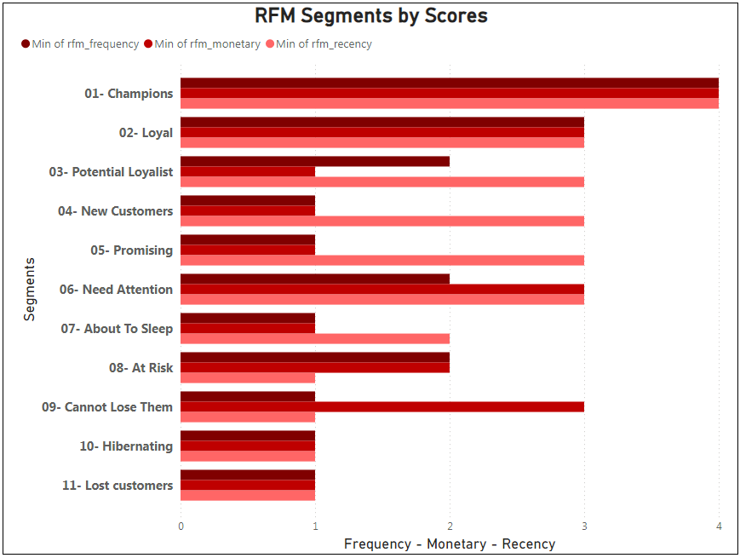
RFM Segments by score
RFM Segmentation in Action:
We have sorted customers by recency, with the most recent purchasers at the top. Since customers are assigned scores from 1-5, the top 20% of customers (customer 12, 11, 1) receive a recency score of 5, the next 20% (the next 3 customers 15, 2, 7) a score of 4, and so on.
Similarly , we can then sort customers by frequency from most to least frequent, assigning the top 20% a frequency score of 5, etc. For the monetary factor, the top 20% of customers (big spenders) will be assigned a score of 5 and the lowest 20% a score of 1.
Finally , we can rank these customers by combining their individual R, F, and M rankings to arrive at an aggregated RFM score.

Slide 24
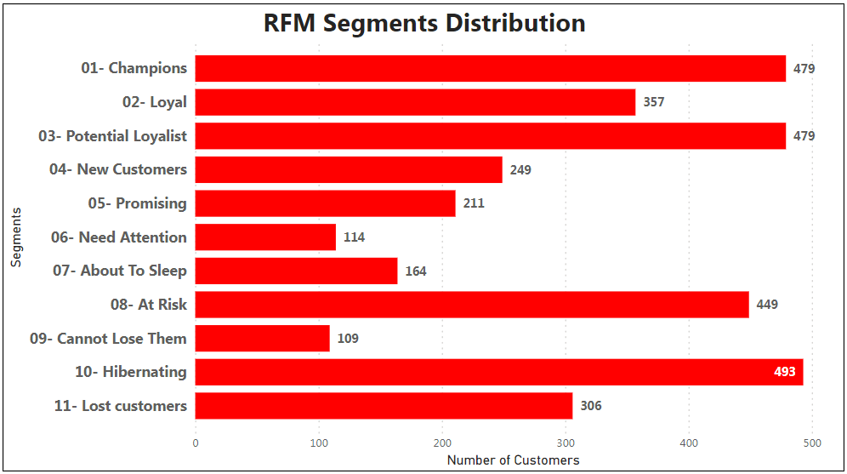
RFM Segments Distribution
Eleven Segments:
We can now split our customers list into 11 customer segments based on their total scores. The largest segment is “Hibernating” (493 customers), followed by “At Risk” (449 customers), “Champions” (479 customers) and “Potential Loyalist” also (479 customers). The smallest segment is “Cannot Lose Them” (109 customers).
NOW , you can use RFM analysis to identify your most valuable customers and target your marketing campaigns accordingly.

Slide 25
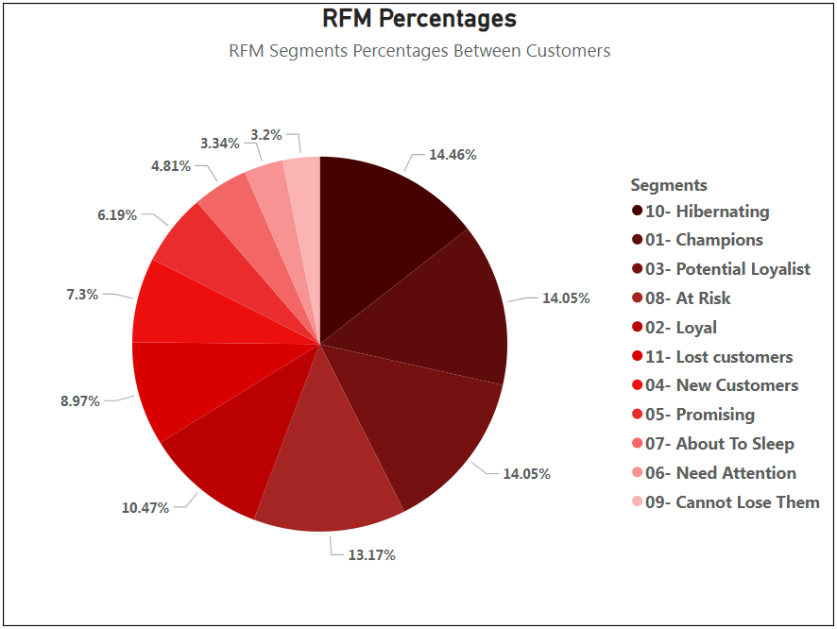
RFM Segments Percentages
Segments in Order:
We can see that the largest segment is “Hibernating” with 14.46% and the “Champions” segment comes in the second place with a slight difference making 14.05% of all the customers.
The “Potential loyalist” segment shares the same rank with “Champions” segment with an equal percentage of 14.05%.
The smallest segments are “Cannot lose them” with 3.2%, “Need Attention” with 3.34% and “About to sleep” with 4.81%.

Slide 26
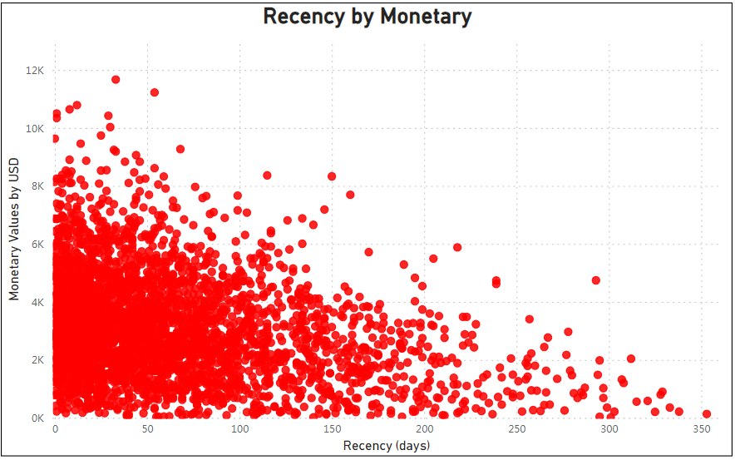
Recency by Monetary
Trends and Patterns:
The Majority of customers generated revenue between 0 to $6000.
The customers who generated the most revenue have purchased the most recent.
A moderate amount of revenue have been generated between the last 50 to 100 days.
A moderate amount of customers have generated revenue between 6K to 8K USD.
Fewer customers have purchased more than $8000.
The fewest customers have purchased more than 200 days ago and they generated low revenue.

Slide 27
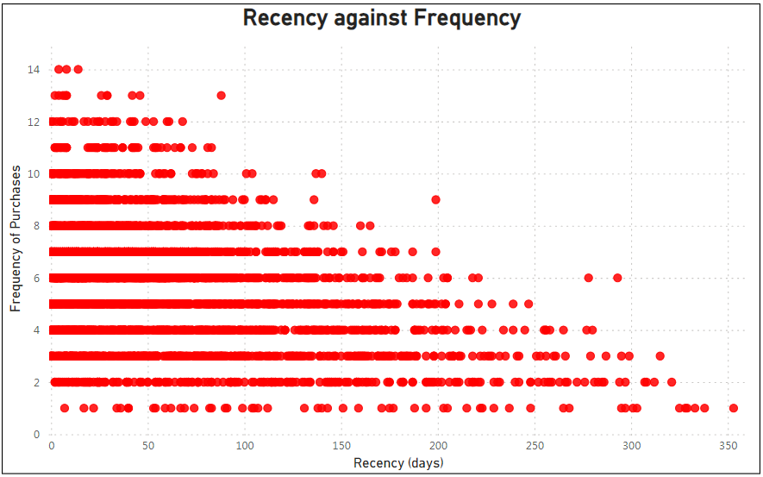
Recency by Frequency
Trends and Patterns:
The Majority of customers have purchased recently (in the last 150 days).
Customers who purchased the most frequent (more than 10 times) are also the most recent to purchase (in the last 100 days).
Customers who purchased the least recent (200+ days) are less frequent purchasers (6 purchases MAX).
A minority of customers are one time purchasers and they are distributed almost equally on the whole year.

Slide 28
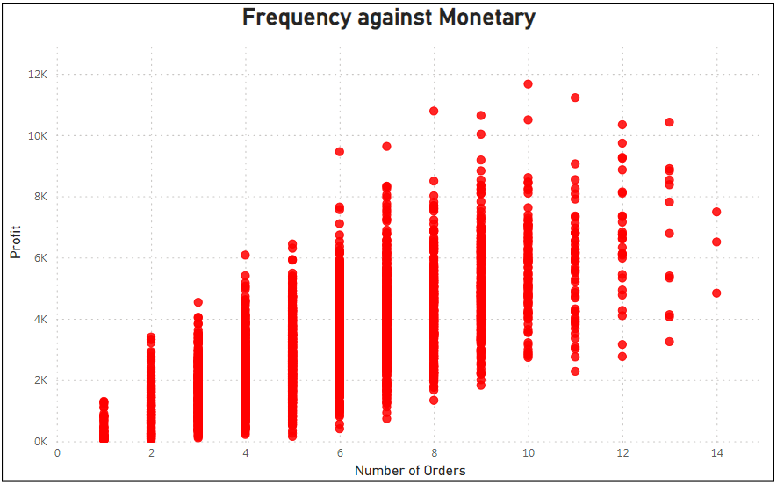
Frequency by Monetary
Trends and Patterns:
Naturally, there is a positive relationship between the frequency (Number of orders) and the monetary (Profit), meaning; the higher the profit the higher the count of orders, with some exceptions for customers who purchased more than 12 times.
Few customers have purchased more than 12 times and they still in a high profit range from 2K to 10K approximately.
Also, few customers have generated profit more than 8k but they share a tendency for purchasing more frequent than 6 times.

Slide 29
The data still have more to say
More insights
The model development phase has generated some extra insights that might be helpful.

Slide 30
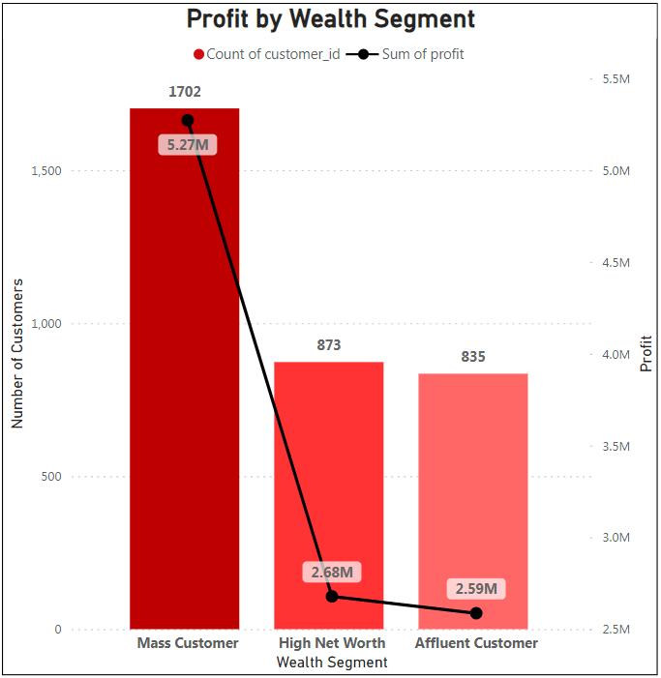
Profit by Wealth Segment
Observations:
The majority of customers are in the “Mass customers” segment (1702 customers) and they have generated about 5.27M USD.
“High Net Worth” segment comes second with 873 customers making 2.68M USD.
“Affluent Customer” segment comes third with 835 customers with 2.59M USD.

Slide 31
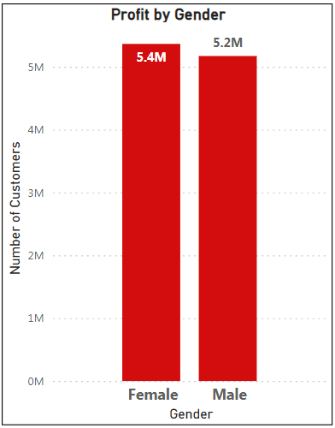
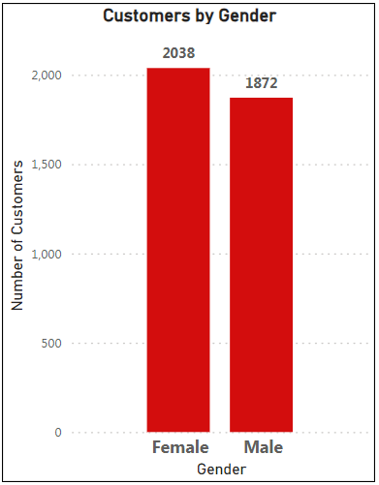
Gender/Profit
Observations:
The majority of customers are females (2038 customers) and they generate slightly more profit than the male customers do with 5.4M USD.
Male customers (1872 customers) are slightly fewer than females making 5.2M USD.

Slide 32
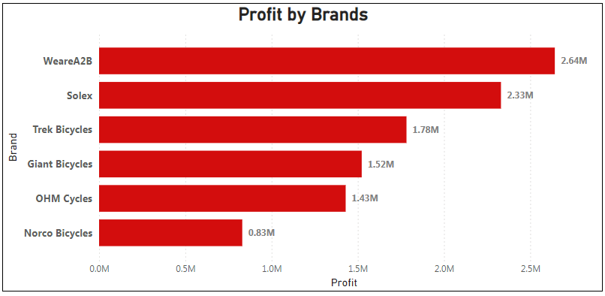
Profit by Brands
Observations:
WeareA2B comes in the first rank making 2.64M USD.
In the second rank, Solex comes with 2.33M USD.
Norco Bicycles make the least of the profit with 0.83M USD.

Slide 33
04
Interpretation​
Let’s thoroughly understand what the data has told us

Slide 34
Focus Areas
Age
Wealth
Gender
The Middle adults are the best target for you.
Mass customers are majority and profitable.
Both Females and males may be targeted equally.
Industry
Address
RFM Segments
Manufacturing and financial services are promising.
Customers who are living in NSW are majority.
“Champions” and “Potential Loyalist” are promising.

Slide 35
Recommendations:
Based on the RFM analysis, here are some recommendations for what Sprocket Central could do:
Retaining high-value customers!
The company has a large segment of “Hibernating” customers (493) who haven't purchased recently. Win them back with targeted campaigns and special offers. Additionally, the “At Risk” segment (449) are previously frequent high-spending customers who need attention to prevent churn. Address their concerns and offer incentives to keep their business. They should prioritize retaining these segments because they likely have a high customer lifetime value.

Slide 36
More Recommendations!
Nurture promising segments
The “Potential Loyalists” and “Promising” segments show buying potential. Engage them with personalized recommendations and loyalty programs to convert them into high-value customers.

Slide 37
More Recommendations!
Maintain relationships with loyal customers
Convert new customers
The “New Customers” segment has promise, but they need encouragement to come back more often and spend more. Targeted promotions and special offers can help move them up the customer value ladder.
The “Champions” and “Loyal” segments are valuable assets. Reward their loyalty with exclusive benefits and keep them engaged with the brand.

Slide 38
Time has passed!

Slide 39

We've reached the end of our journey!

Slide 40
My chief motive was to create a machine which would enable men to travel with convenience and celerity without the aid of horses or other animals.
”
—Karl Drais

Slide 41
Resources
Visuals:
Free Google Slides themes and Powerpoint templates | Slidesgo
Technical Tools:
Linux (ubuntu 22.4 LTS)
PostgreSQL
Microsoft Power Bi
Microsoft Excel
Google Slides
Theoretical and Technical help:
PostgreSQL Tutorial (w3schools.com)
RFM(E) Customer Segmentation - Recency, Frequency, Monetary (or Engagement) Analysis - ShopUp

Slide 42
You can have data without information, but you cannot have information without data.
- Daniel Keys Moran

Slide 43
Thank you!
Do you have any questions?
Please get in touch:
+20 128 9133 238
+20 101 6749 100
aymanali2193@gmail.com

